Slide 1


TITLE PAGE – 05/29/25
FIRSTLIGHT FIBER
PEMM PROJECT
STATUS REPORT

Slide 2


AGENDA
POLYGONS
SCHEDULE
FABRIC ID LOCATION STATUS
FIBER INSTALLATION UPDATES
OPEN DISCUSSION

Slide 3
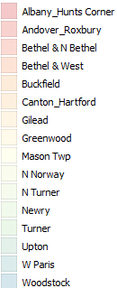
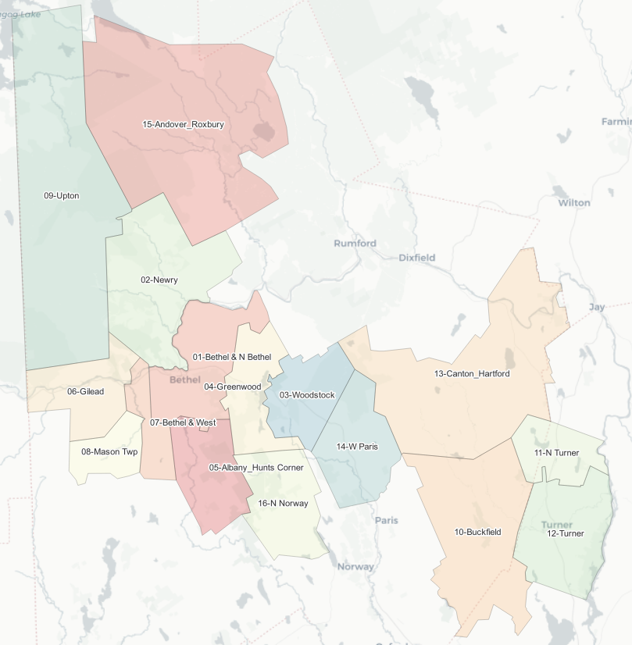
DESIGN – POLYGONS
PEMM Project Polygons
16 Builds separated by Polygon’s

Slide 4
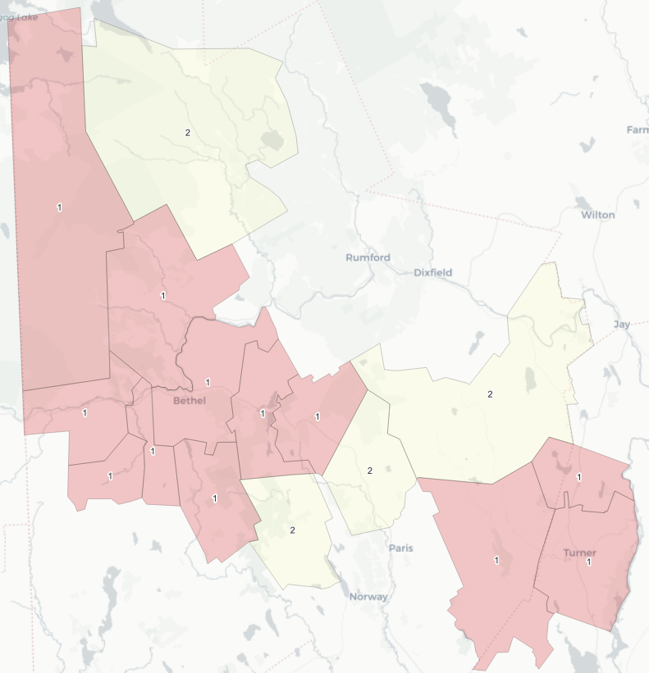
PROJECT TIMEFRAME
2025 & 2026 PEMM SCHEDULE – PHASE 1

Slide 5
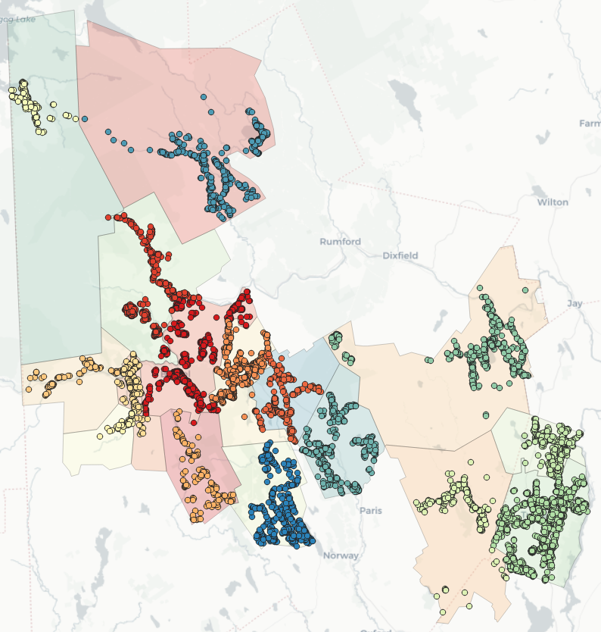
DESIGN – FABRIC IDs
Fabric IDs
*Fabric ID Total in Bethel & Newry was updated due to exchange boundary

Slide 6
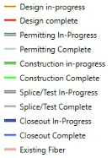
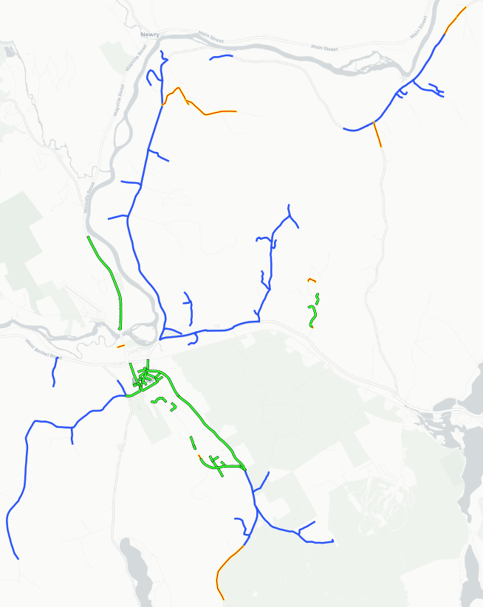
INSTALL UPDATE
Fiber Install Status - Bethel & N. Bethel

Slide 7
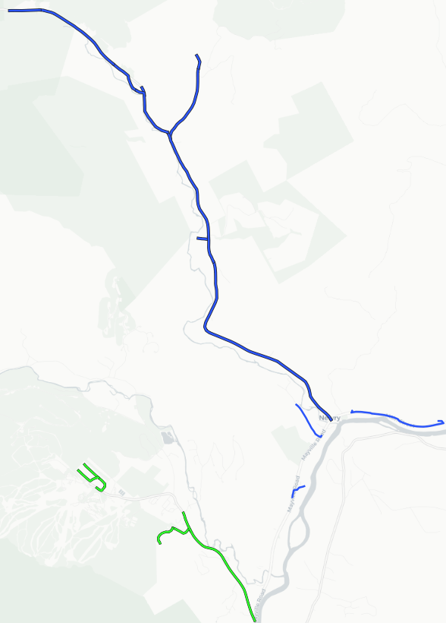
INSTALL UPDATE
Fiber Install Status - Newry

Slide 8
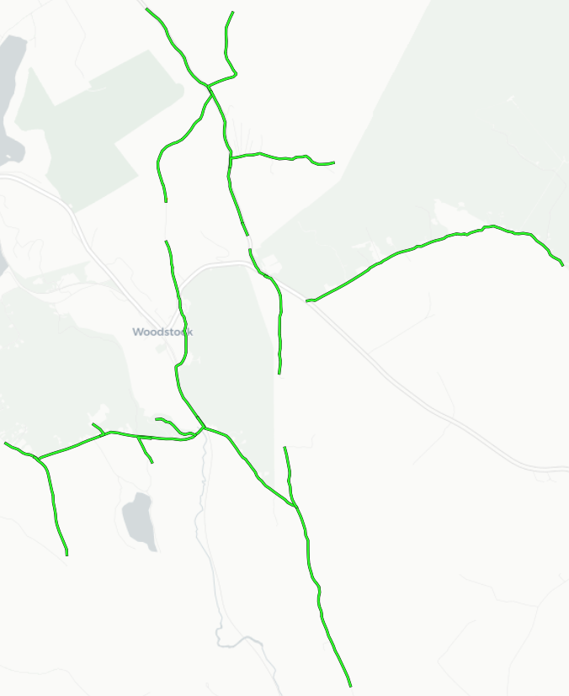
INSTALL UPDATE
Fiber Install Status - Woodstock

Slide 9
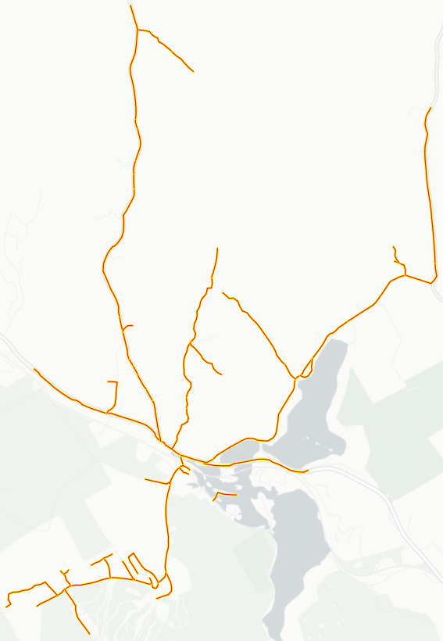
INSTALL UPDATE
Fiber Install Status - Greenwood

Slide 10
FIRSTLIGHT FIBER
PEMM PROJECT
STATUS REPORT
THANK YOU!

